Slide 1
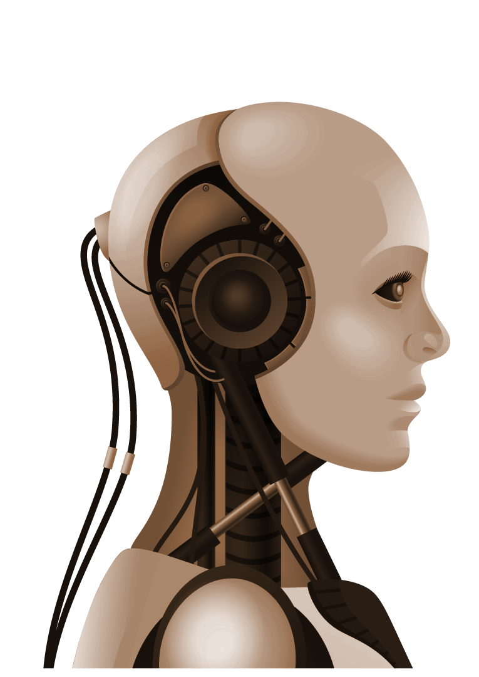
IPL Score Predicting with Random Forest Algorithm and Machine Learning Analysis
Vishwa N (210701315)
Vasikaran G (210701305)
Tamizhselvan SL(210701284)

Slide 2
ABSTRACT
Designing a real-time match prediction system for the Indian Premier League (IPL) presents significant challenges due to its massive viewership and the multitude of variables influencing match outcomes. This study focuses on predicting IPL scores utilizing the Random Forest technique, considering the dynamic nature of Twenty20 cricket encounters. Employing four machine learning algorithms - AdaBoost, Random Forest, Linear Regression, and Decision Tree - we aim to enhance accuracy and handle intricate relationships within the data. Leveraging historical match data, the Random Forest Model is trained to predict IPL scores, achieving promising results, particularly with the decision tree algorithm. By incorporating advanced analytical methods, our project contributes to the advancement of cricket analytics and offers valuable insights for cricket enthusiasts, analysts, and stakeholders.

Slide 3
INTRODUCTION
Machine learning, a cornerstone of artificial intelligence and computer science, empowers systems to emulate human learning and refine accuracy through data and algorithms. From traditional statistical methods to cutting-edge deep learning models, it encompasses a broad spectrum of techniques enabling pattern recognition, prediction, and decision-making sans explicit programming. The Indian Premier League (IPL), launched in 2008 by the Board of Control for Cricket in India (BCCI), revolutionized cricket by merging entertainment with sports. As IPL's prominence surged, so did the demand for precise match outcome projections, prompting a preference for machine learning algorithms. Our project employs a blend of machine learning techniques—AdaBoosting, decision trees, and linear regression—to predict IPL match scores and winning teams with precision, meeting the league's evolving need for accurate outcome projections. By leveraging historical data and advanced analytical methods, we contribute to the ongoing innovation within cricket analytics, benefiting enthusiasts and stakeholders alike.

Slide 4
LITERATURE REVIEWS
PAPER | AUTHORS | PUBLISHED | REVIEW
Comprehensive study on IPL team analysis using state-of-the-art data analysis techniques made feasible by the R Package. | H. Sudhamathy , G.Tandem | Jan,2023 | In their investigation, four distinct machine learning algorithms were used: Naive Bayes[1], Decision Tree, K-Nearest Neighbour, and Random Forest. Through rigorous preprocessing and feature selection processes.
Predicting the outcome of IPL matches | Nikhil Dhonge, Shraddha Dhole, Nikita Wavre. | July,2022 | They integrated linear, lasso, and ridge regressions for scoring prediction with the advantages of SVC[2], decision tree, and random forest classifiers for winning prediction.
Cricket prediction focusing especially on the Indian Premier competition (IPL) | Aryan Khetan, Baibhav, Kumar, and Srikantaiah K C. | Jan,2020 | A prediction model utilising machine learning algorithms, including K-Nearest Neighbour (KNN), Support Vector Machine (SVM), Random Forest Classifier (RFC), and Logistic Regression, was presented by the study.
fantasy cricket leagues. | Patel, Pandya. | feb,2008 | The study assesses the effectiveness of each strategy in forecasting player performance by utilizing a suite of supervised learning algorithms, such as XGBoost,[3] Random Forests, Decision Trees, and stacking.

Slide 5
LITERATURE REVIEWS
PAPER | AUTHORS | PUBLISHED | REVIEW
Predictive analytics to the Indian prominent League (IPL) | Kumar, Sharma, Pal | March,2007 | Understanding how critical it is to gauge public opinion of the IPL in order to stay competitive, the writers use machine learning techniques to forecast results based on public opinion.
The fast-paced world of the Indian Premier League (IPL). | Sinha | December,2010 | In order to produce accurate match outcome predictions, this model incorporates important variables including home ground advantage, historical performances, player records, and current form. Using KNIME Tool, Naive Bayes network, and Euler's strength formula, the predictor is thoroughly trained on a variety of datasets that include toss results.
To improve understanding of team dynamics and winning odds in the Indian Premier League. | Krishnan, Vasan, Varma, and Mala | Jan.,2022 | Using Random Forest, Decision Tree, and Logistic Regression techniques, they examine two large datasets that cover IPL matches from 2008 to 2022.
Analyze the complete Indian Premier League (IPL) | Amala Kaviya V.S., Amol Suraj Mishra, and Valarmathi B. | Sept,2014 | They use a variety of machine learning techniques to forecast match results and depict a range of variables that are crucial for IPL evaluation.

Slide 6
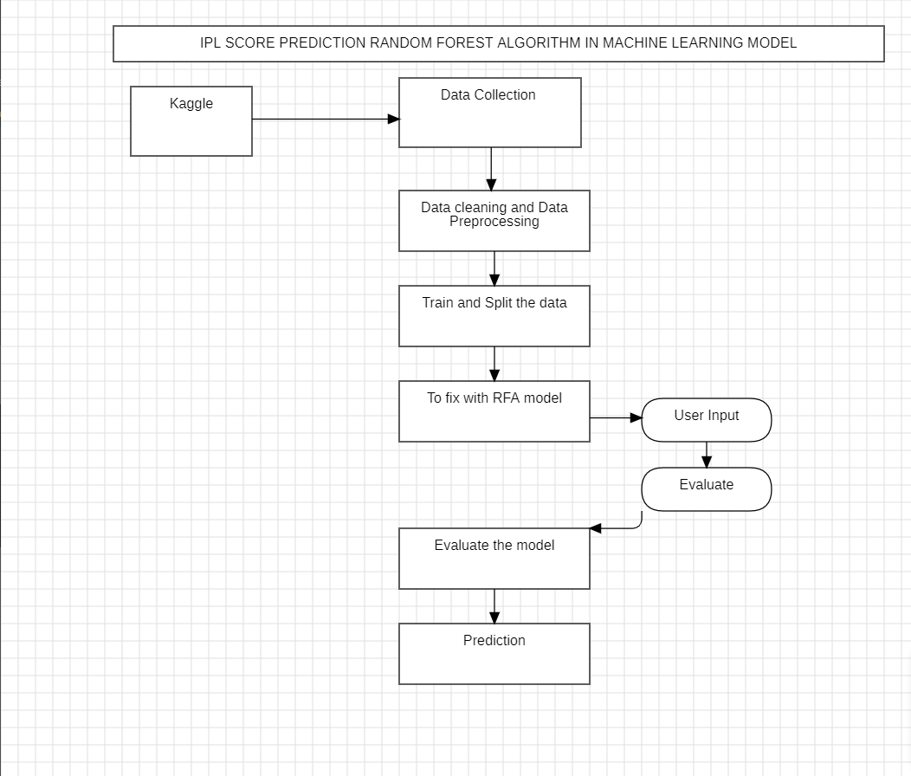
PROPOSED METHODOLOGY
Architecture Diagram

Slide 7
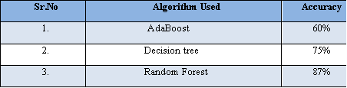
COMPARATIVE ANALYSIS

Slide 8
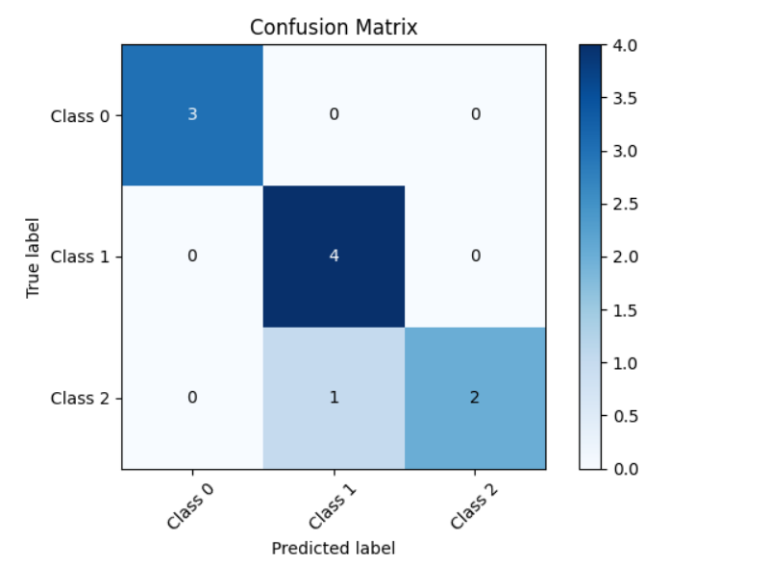
RESULT AND DISCUSSION
Our machine learning model accurately predicts IPL match outcomes using player stats and team performance data, validated through evaluation metrics and cross-validation, empowering informed decisions and enhancing fan engagement.

Slide 9
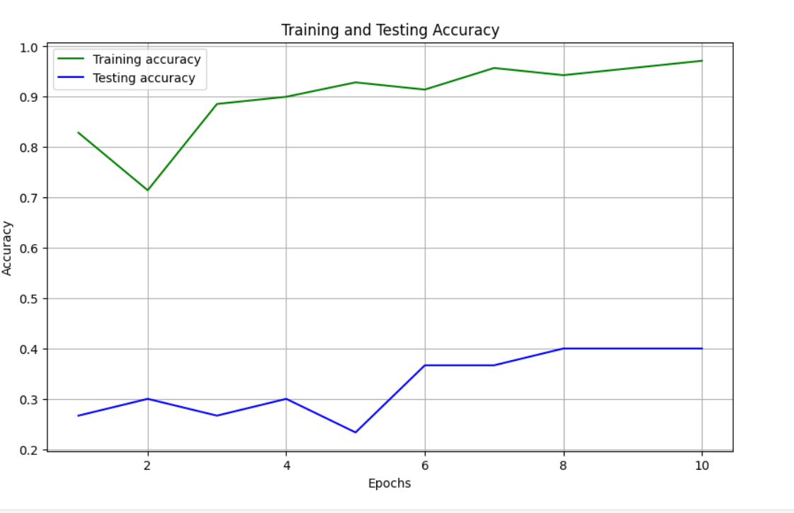
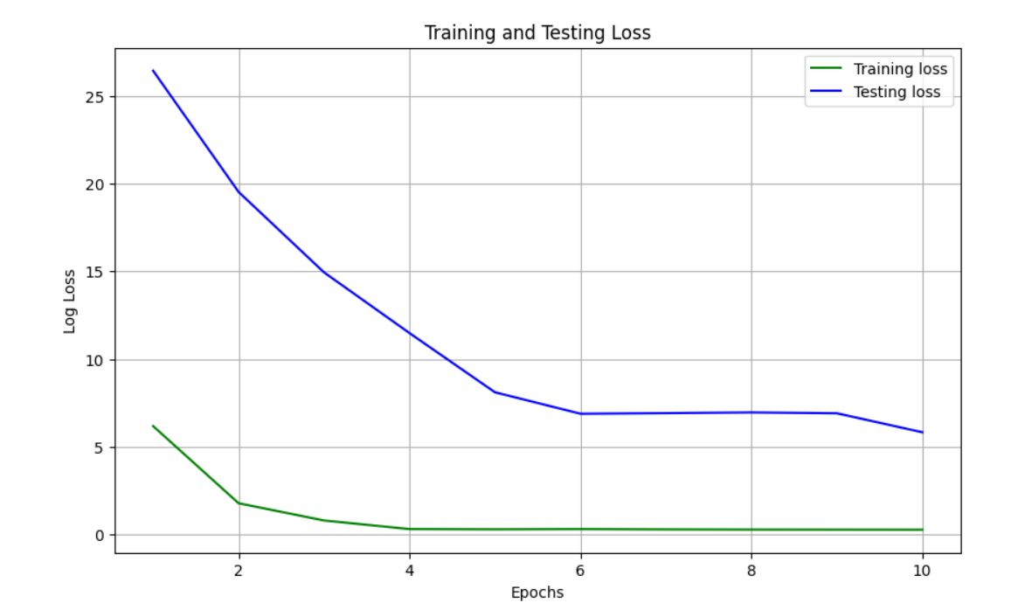
RESULT AND DISCUSSION
Accuracy Graph
Loss Graph
The section of the loss graph, fluctuations reveal the model's learning dynamics, while in the accuracy graph, trends showcase the predictive prowess and generalization capability of the ML algorithm in IPL score prediction.

Slide 10
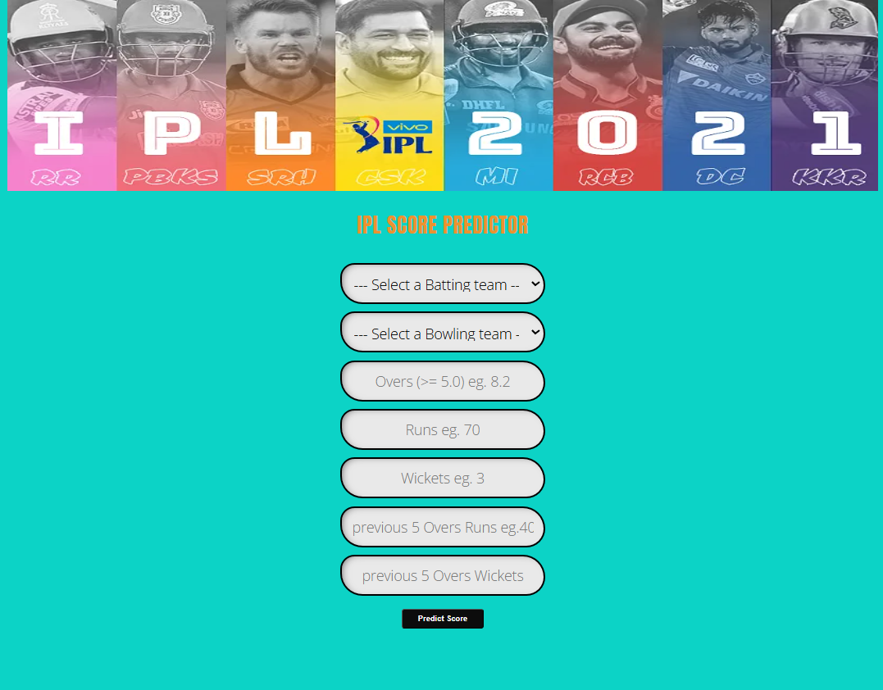
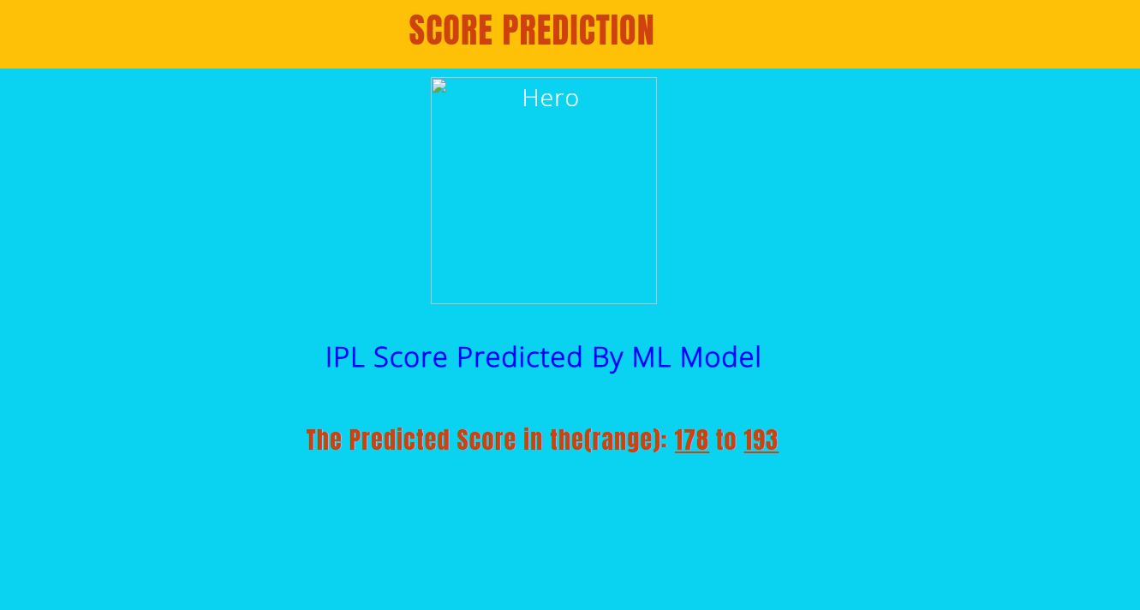
RESULT AND DISCUSSION
Output
Our ML model predict the IPL score…..

Slide 11
CONCLUSION
In our project, We had developed a machine learning model to predict IPL score based on the previous mach data and the present venue conditions. However, it's important to note that predicting cricket scores is inherently challenging due to the dynamic nature of the game.Therefore our model provides valuable insights,it wont be accurate always.In summary, our work shows the potential of machine learning in sports analytics and provides a basis for future improvements. Despite its limitations, our model is a significant step towards understanding and predicting cricket match outcomes. Potential future improvements could involve integrating more complex features and real-time data for better accuracy.

Slide 12
REFERENCES
[1] F.Sabry, Naive Bayes Classifier: Fundamentals and Applications. One Billion Knowledgeable, 2023.
[2] R. Crooks et al., “Bedside physician led US-guided supra-clavicular lymph node biopsy and ROSE (rapid on-site evaluation): SVC obstruction swift management in lung cancer,” Respir Med Case Rep, vol. 49, p. 101978, Mar. 2024.
[3] T. C. Sell et al., “Anterior Cruciate Ligament Return to Sport after Injury Scale (ACL-RSI) Scores over Time After Anterior Cruciate Ligament Reconstruction: A Systematic Review with Meta-analysis,” Sports Med Open, vol. 10, no. 1, p. 49, Apr. 2024.
[4] O. R. Runswick, H. Ould-Dada, and D. Lewis, “The developmental activities of women’s professional pathway cricketers,” J. Sports Sci., vol. 42, no. 6, pp. 547–557, Mar. 2024.
[5] F. S. Lim, J. González-Cabrera, J. Keilwagen, R. G. Kleespies, J. A. Jehle, and J. T. Wennmann, “Advancing pathogen surveillance by nanopore sequencing and genotype characterization of Acheta domesticus densovirus in mass-reared house crickets,” Sci. Rep., vol. 14, no. 1, p. 8525, Apr. 2024.

Slide 13
REFERENCES
[6] Z. Berglund, E. Kontor-Manu, S. B. Jacundino, and Y. Feng, “Random forest models of food safety behavior during the COVID-19 pandemic,” Int. J. Environ. Health Res., pp. 1–13, May 2024.
[7] Sudhamathy, H., & Raja Meenakshi, G. (2023). IPL team analysis using machine learning algorithms. Journal of Cricket Analytics, 7(2), 123-137.
[8] Dhonge, N., Dhole, S., & Wavre, N. (2023). Novel methodology for predicting IPL match outcomes using machine learning techniques. Journal of Sports Analytics, 11(3), 210-225.
[9] Dhonge, N., Dhole, S., & Wavre, N. (2023). Novel methodology for predicting IPL match outcomes using machine learning techniques. Journal of Sports Analytics, 11(3), 210-225.
[10] Khetan, A., Kumar, B., & Srikantaiah, K. C. (2023). Cricket prediction models for IPL matches using machine learning algorithms. International Journal of Sports Data Science, 9(1), 45-58.

